Slide 1
Business Case Solving

Slide 2
Tables to be Downloaded
Customers
Suppliers
Employees
Products
Shippers
Orders
Order_Details

Slide 3
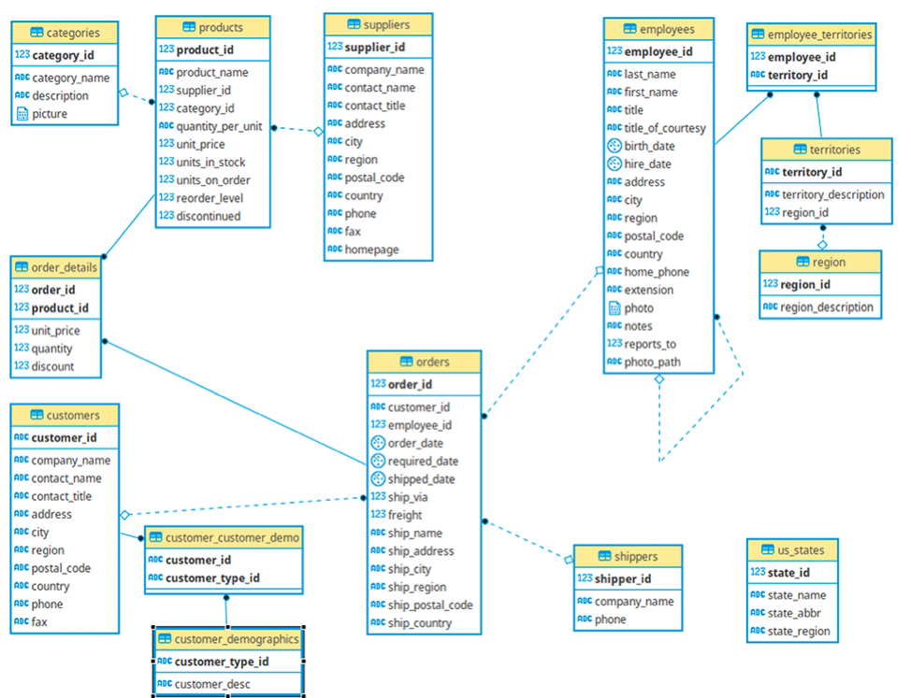

Slide 4
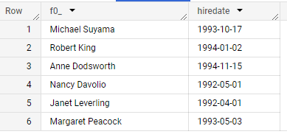
Ques. Fetch the full name and hiring date of all Employees who work as Sales Representatives.
SELECT concat(firstname,' ',lastname), hiredate
from `case-study-398305.CS.employees`
where lower(title)='sales representative'

Slide 5
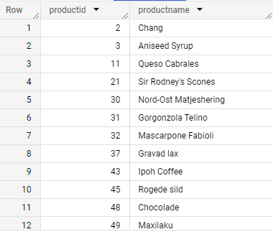
Ques. Which of the products in our inventory need to be reordered? Note: For now, just use the fields UnitsInStock and ReorderLevel, where UnitsInStock is less than the ReorderLevel, ignoring the fields UnitsOnOrder and Discontinued.
select productid, productname
from `case-study-398305.CS.products`
where unitsinstock<reorderlevel
order by 1

Slide 6
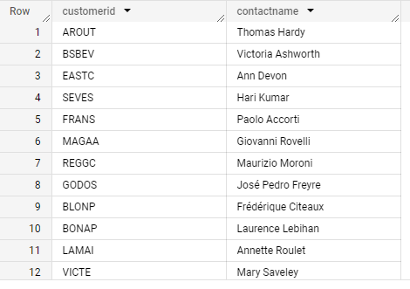
Ques. Find and display the details of customers who have placed more than 5 orders.
SELECT customerid, contactname
FROM `cs01-01.cs.customers`
WHERE customerid IN (SELECT
customerid
FROM `cs01-01.cs.orders`
GROUP BY customerid
HAVING COUNT(DISTINCT orderid) > 5)

Slide 7
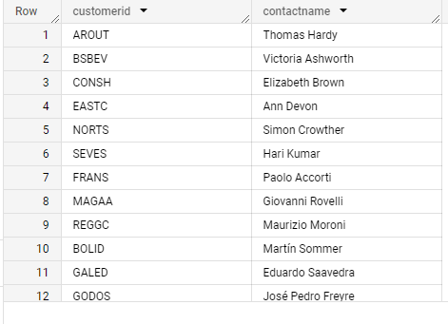
Ques: An employee of ours (Margaret Peacock, EmployeeID 4) has the record of completing most orders. However, there are some customers who've never placed an order with her. Show such customers.
select distinct c.customerid, c.contactname
from `cs01-01.cs.customers` as c
join `cs01-01.cs.orders` as o
on o.customerid=c.customerid
where employeeid!= 4

Slide 8
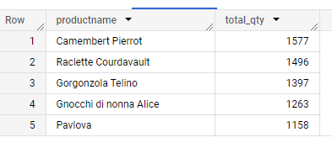
Ques. Retrieve the top 5 best-selling products on the basis of the quantity ordered.
select p.productname, sum(quantity) as total_qty
from `cs01-01.cs.products` as p
join `cs01-01.cs.orders_details` as o
on p.productid=o.productid
group by 1
order by 2 desc
limit 5

Slide 9
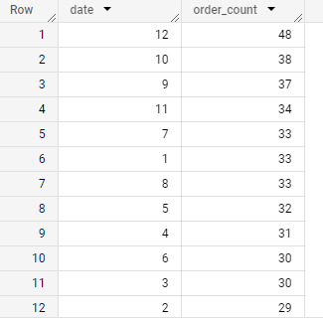
Ques. Analyze the monthly order count for the year 1997.
select extract(month from orderdate) date,
count(orderid) as order_count
from `cs01-01.cs.orders`
where extract(year from orderdate) = 1997
group by 1
order by 2 desc

Slide 10
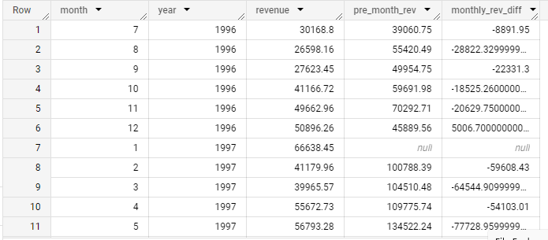
Ques: Calculate the difference in sales revenue for each month compared to the previous month.
with mon_rev as(
select extract(month from o.orderdate) as month,
extract(year from o.orderdate) as year,
round(sum((od.quantity*unitprice)- (discount * od.quantity*unitprice)/100),2) as revenue
from `cs01-01.cs.orders_details` as od
join `cs01-01.cs.orders` as o
on od.orderid=o.orderid
group by 1,2 )
select *, lag(revenue) over(order by month, year) as pre_month_rev,
revenue - lag(revenue) over(order by month, year) as monthly_rev_diff
from mon_rev
order by year, month

Slide 11
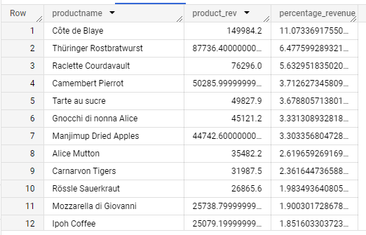
Ques: Calculate the percentage of total sales revenue for each product.
WITH total_rev AS (
SELECT
SUM(unitprice * quantity) AS rev
FROM `cs01-01.cs.orders_details`
), product_rev AS (
SELECT
p.productname,
SUM(od.unitprice * od.quantity) AS product_rev
FROM `cs01-01.cs.products` AS p
JOIN `cs01-01.cs.orders_details` AS od
ON p.productid = od.productid
GROUP BY p.productname
)
SELECT
p.productname,
p.product_rev,
(p.product_rev / t.rev) * 100 AS percentage_revenue
FROM total_rev AS t, product_rev AS p
ORDER BY percentage_revenue DESC

